Slide 1
Acing the Interview: How to answer finance related interview questions
Finance Society
February 18, 2015

Slide 2
Qualitative Knowledge
Tell me about yourself & walk me through your resume
Story is the most important
Drives the interview
Further questions shoot of initial introduction
Have stories for other qualitative questions
Don’t write them out, but know where you are going
Career Center – Resources & Mock Interviews

Slide 3
Financial Knowledge
Describe how the 3 financial statements connect
Keep it brief - If they want more detail they will ask
Suppose depreciation increases by 10…
How does it affect the 3 statements?
Pros and Cons – Equity vs. Debt
3 Valuation Techniques
Price a bond
Discount or Premium Bond
Notes:
What are the 3 financial statements?
Can you describe what they are?
How do they connect?
Investopedia
If you had to choose 1 statement, what would it be?
If you had 2 financial statements, what would they be?
Who knows what depreciation is?
What does it impact?
Solvency – poor times is
Dilutes owners interest
Tax advantages of debt, interest can be deducted on tax return

Slide 4
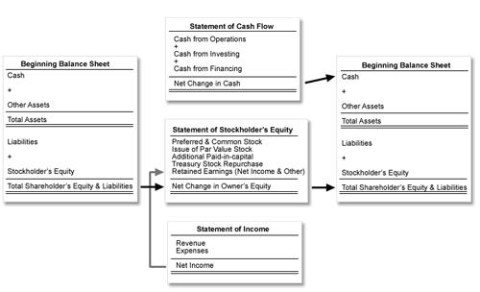
Financial Knowledge
Notes:
What are the 3 financial statements?
Can you describe what they are?
How do they connect?
Investopedia
If you had to choose 1 statement, what would it be?
If you had 2 financial statements, what would they be?
Who knows what depreciation is?
What does it impact?

Slide 5
Current Events Knowledge
Quantitative Easing
Pitch a stock
What is your opinion on the stock market
Interest Rates
Formulate an opinion
Notes:
Ask someone to pitch a stock – AMEX

Slide 6
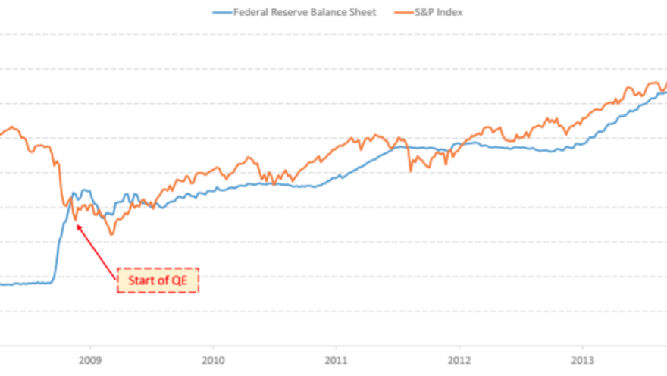
Current Events Knowledge

Slide 7
Other
Reasons for a low GPA
Get a good night sleep & get a good night’s sleep
Get their business cards
Write notes on the back of them
Bring a Padfolio
Use Resume Paper
You can’t know all the answers
CONFIDENCE

